Slide 1
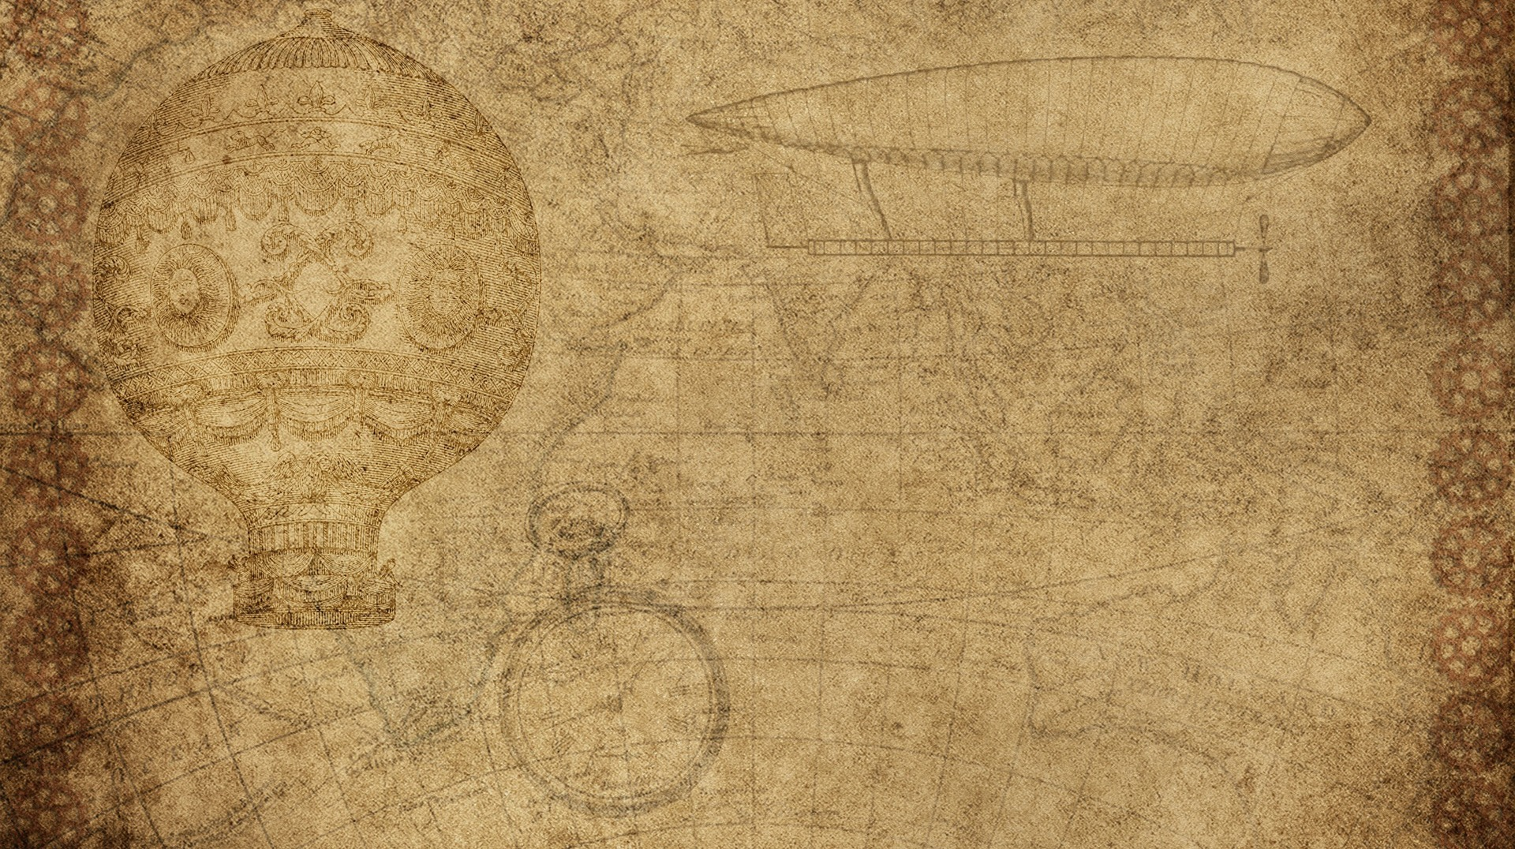

our Invention
Learn from our notes
Team binary brain
| Rashmitha ap | sanjana r rao | nireeksha v | thrisha

Slide 2

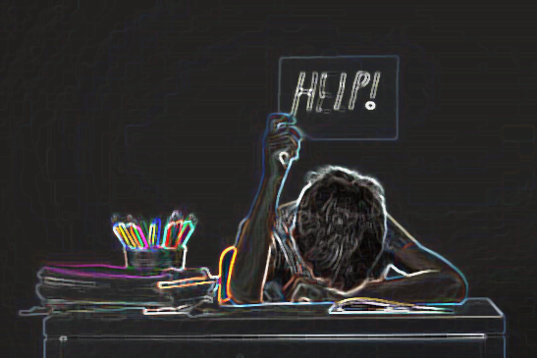
The problem
Students read, but do they really learn..?!
→ Read notes
→ Reads them again
→ Try to remember again
→ No idea what they are weak in…

Slide 3

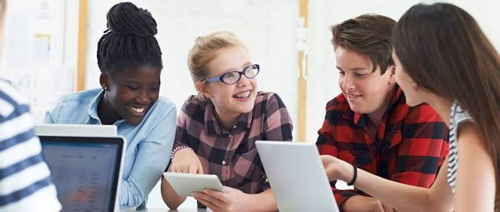
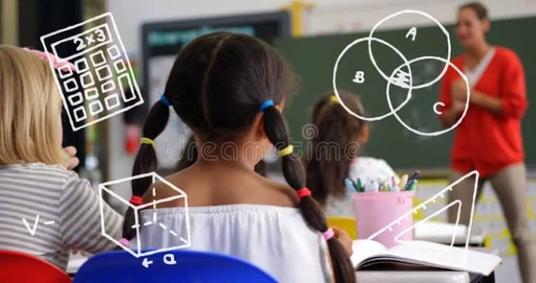
Our solution..!!
What if your notes could teach youuuu.!
📄 STUDENT'S NOTES
┌──────┼────────┐
Topics Questions Flashcards
↓
📝 Quiz
↓
📊 Score
↓
🎯 Weak Topics

Slide 4

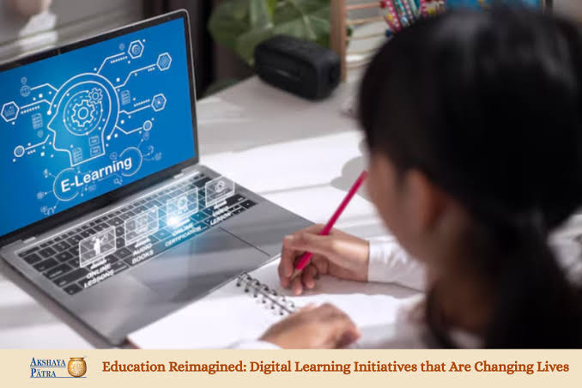
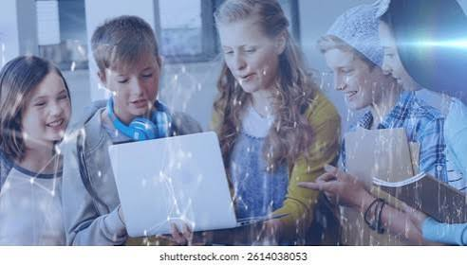
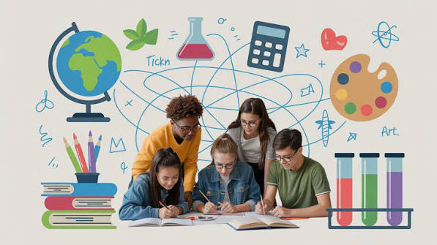
How it works
Upload
Extract
Topics
Analyze
Generate
Topics
Analyze
Performance

Slide 5


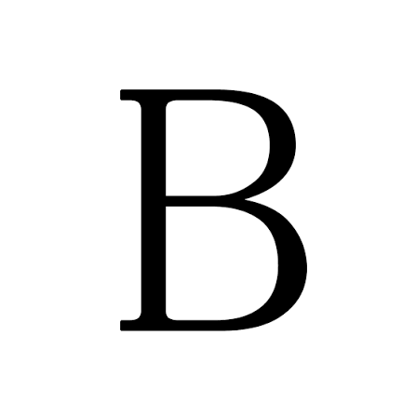

The quizzz…
What is the main purpose of normalization in DBMS..??
Increase data redundancy
Reduce data redundancy
Delete all tables
<Insert pictures or drawings of your invention design/building process>
*you can insert a new slide for these pictures/drawings if you need to!

Slide 6
The special part : weak topics

Slide 7

TECHNOLOGY
TECH
AI API
SQ Lite
PURPOSE
Generate Topics/Questions
Store Qiz Results
TECH
HTML/CSS/Java Script
Python & Flask
PURPOSE
Website
Backend

Slide 8
Current prototype
Text Notes
Topic Etraction
Question Genaration
Quiz
Scoring
Weak Topic Detection

Slide 9

Future scope
PERSONALIZED PRACTICE
PROGRESS
DASHBOARD
HANDWRITTEN
NOTES
UPLOAD
FILES
MULTIPLE LANGUAGE

Slide 10
THANK YOU…

